Slide 1
HTML Tables and Forms
Module-2: Chapter 5

Slide 2
HTML Tables
A grid of cells
A table in HTML is created using the <table> element
Tables can be used to display:
Many types of content
  Calendars, financial data, lists, etc…
Any type of data
  Images
  Text
  Links
  Other tables

Slide 3
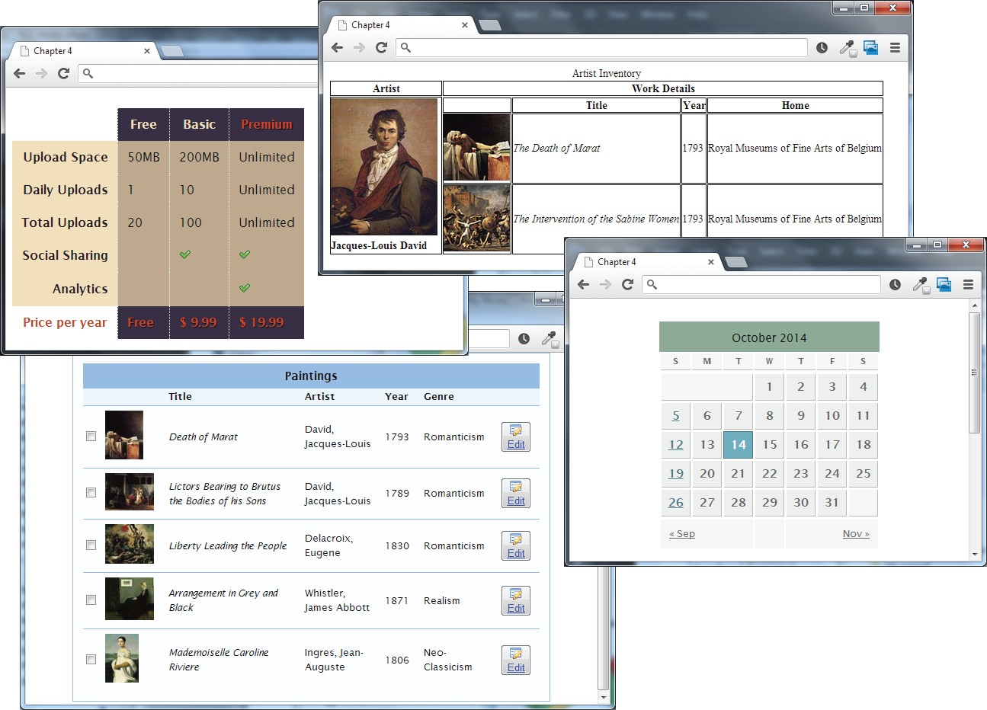
HTML Tables
Example usages

Slide 4
Table Basics
Rows and cells
an HTML <table> contains any number of rows (<tr>)
each row contains any number of table data cells (<td>)
Content goes inside of <td></td> tags
<table>
<tr>
<td>The Death of Marat</td>
</tr>
</table>
content

Slide 5
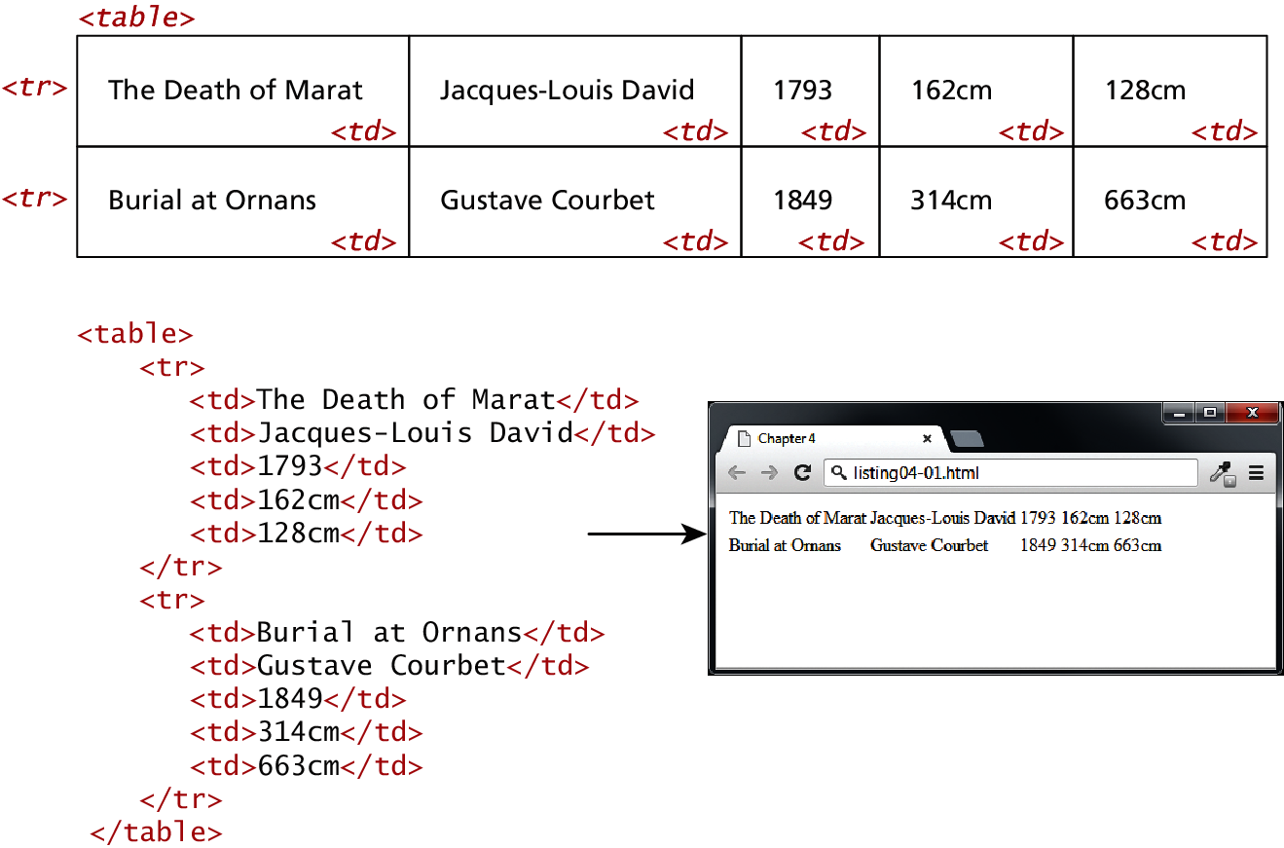
A Simple Example

Slide 6
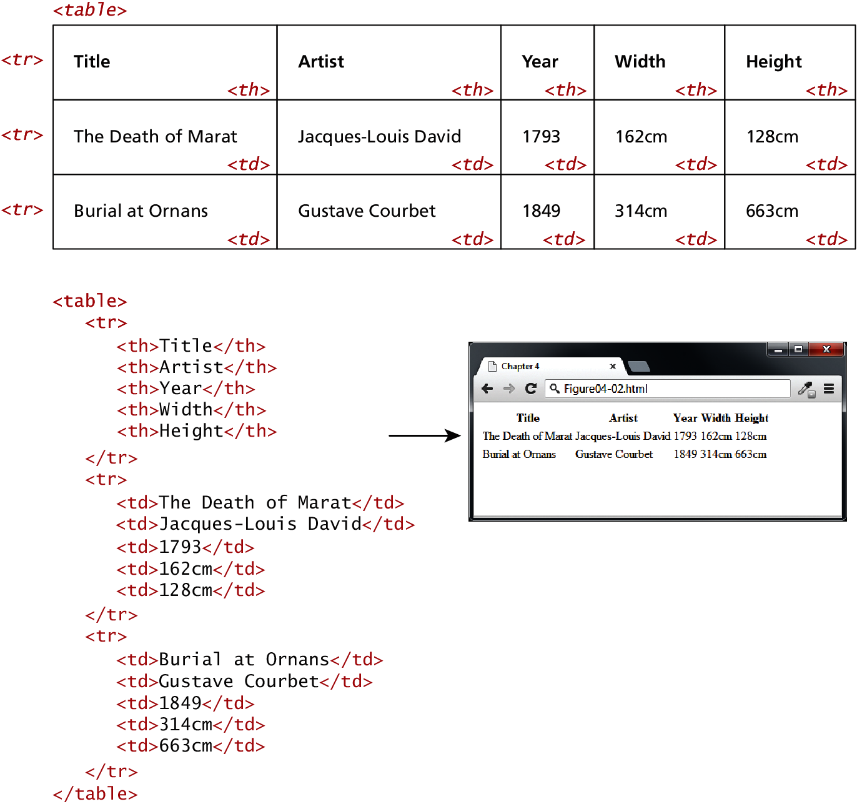
With Table Headings
th

Slide 7
Why Table Headings
A table heading <th>
Browsers tend to make the content within a <th> element bold
<th> element for accessibility (it helps those using screen readers)
Provides semantic information about the row being a row of headers

Slide 8
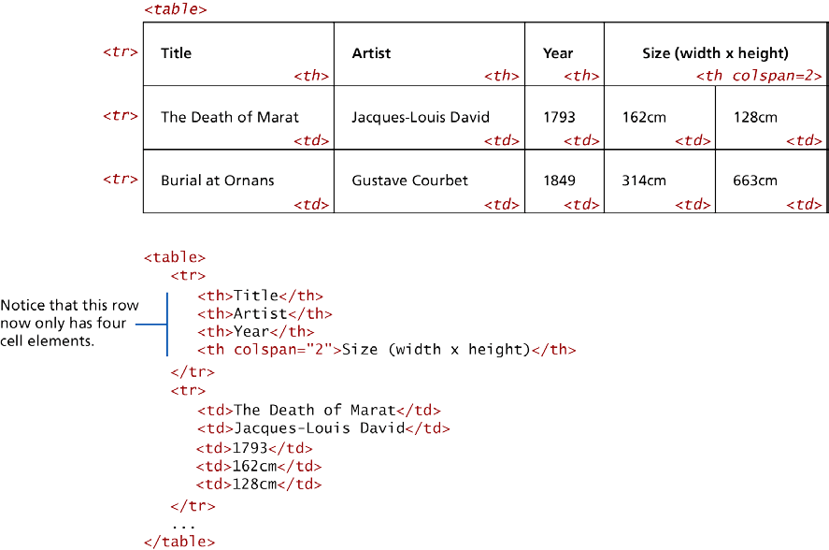
Spanning Rows and Columns
Each row must have the same number of <td> or
<th> containers. If you want a given cell to cover several columns or rows, use the colspan or rowspan attributes

Slide 9
Web Accessibility
Not all web users are able to view the content on web pages in the same manner.
The term web accessibility refers to the assistive technologies, various features of HTML that work with those technologies, and different coding and design practices that can make a site more usable for people with visual, mobility, auditory, and cognitive disabilities.
In order to improve the accessibility of websites, the W3C created the Web Accessibility Initiative (WAI)
Web Content Accessibility Guidelines

Slide 10
Accessible Tables
More about the scope="col" attribute:
From the text:
It is quite revealing to listen to reader software recite the contents of a table that has not made these connections. It sounds like this: “row 3, cell 4: 45.56; row 3, cell 5: Canada; row 3, cell 6: 25,000; etc.”
However, if these connections have been made, it sounds instead like this: “row 3, Average: 45.56; row 3, Country: Canada; row 3, City Count: 25,000; etc.,” which is a significant improvement.

Slide 11
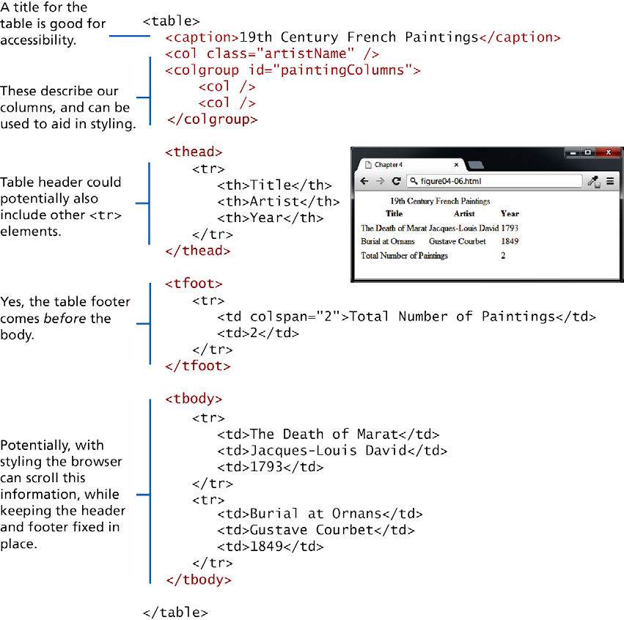
Additional table tags
<caption>
<col>,<colgroup>
<thead>
<tfoot>
<tbody>

Slide 12
Styling Tables
The old ways deprecated
In HTML5 it is left to CSS. However legacy support for deprecated HTML attributes still exist
width, height—for setting the width and height of cells
cellspacing—for adding space between every cell in the table
cellpadding—for adding space between the content of the cell and its border
bgcolor—for changing the background color of any table element
background—for adding a background image to any table element
align—for indicating the alignment of a table in relation to the surrounding container

Slide 13
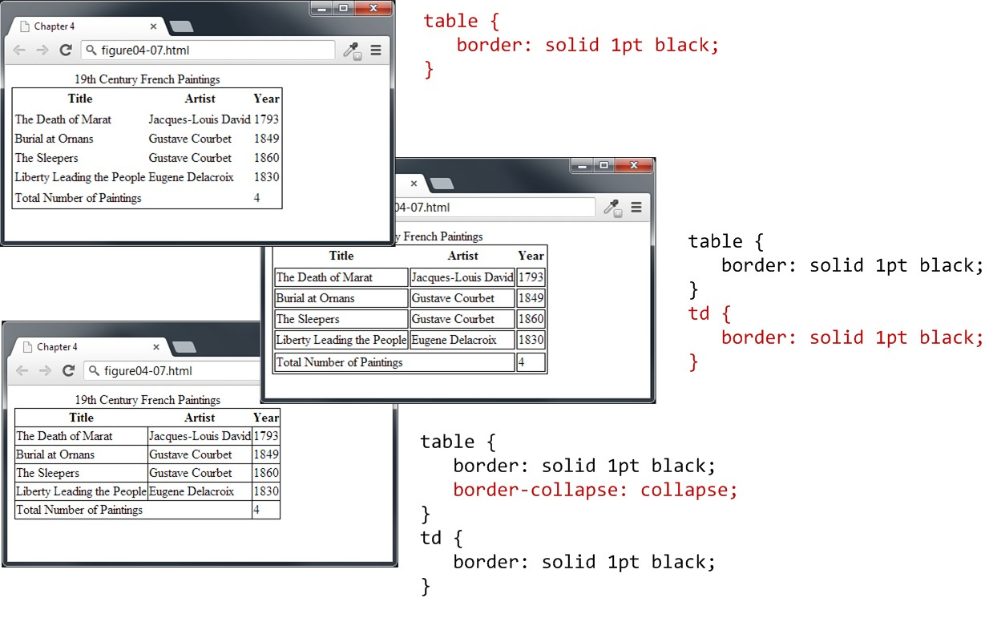
Styling Tables
Borders

Slide 14
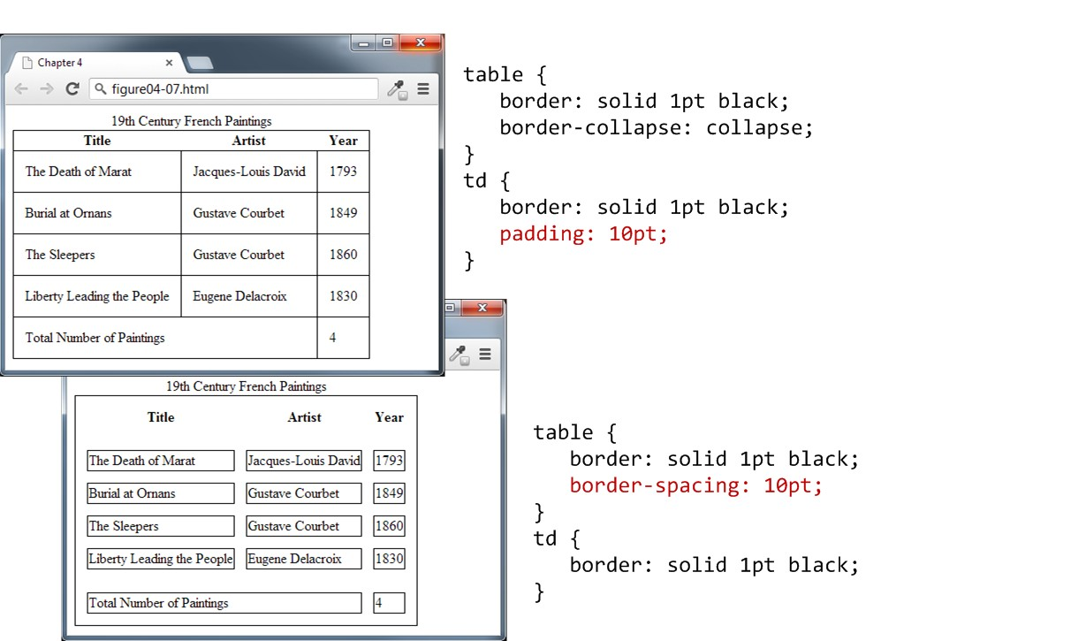
Styling Tables
Padding and spacing

Slide 15
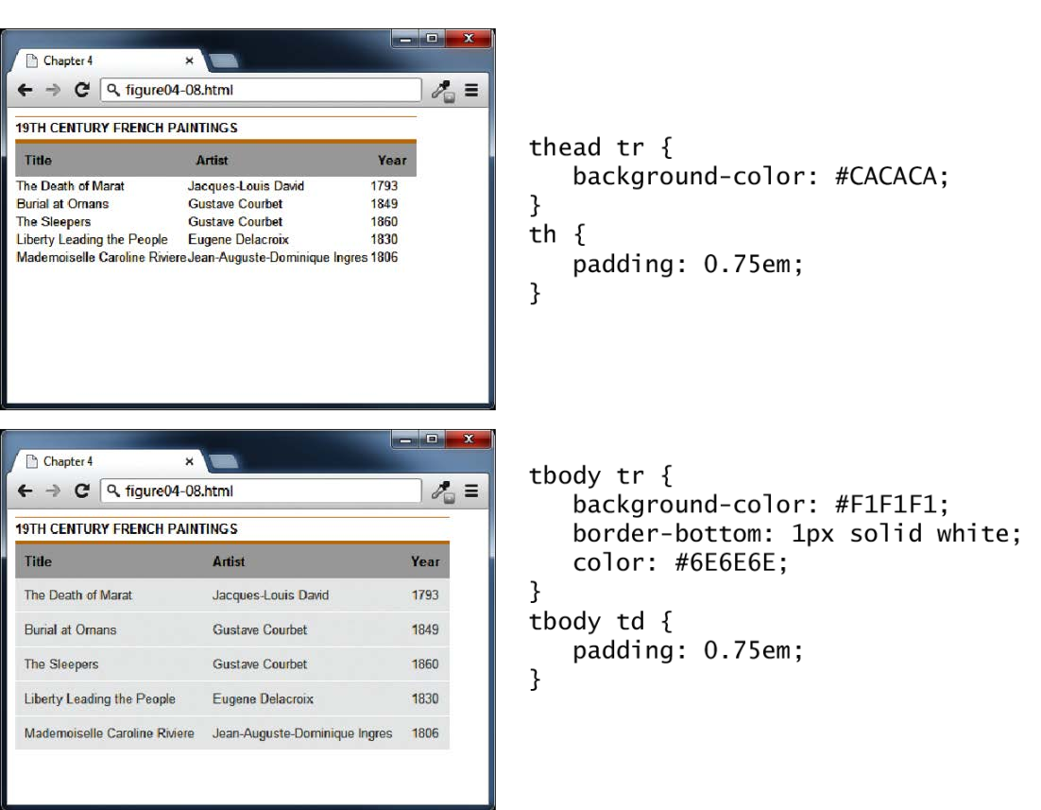
Styling Tables
Examples

Slide 16
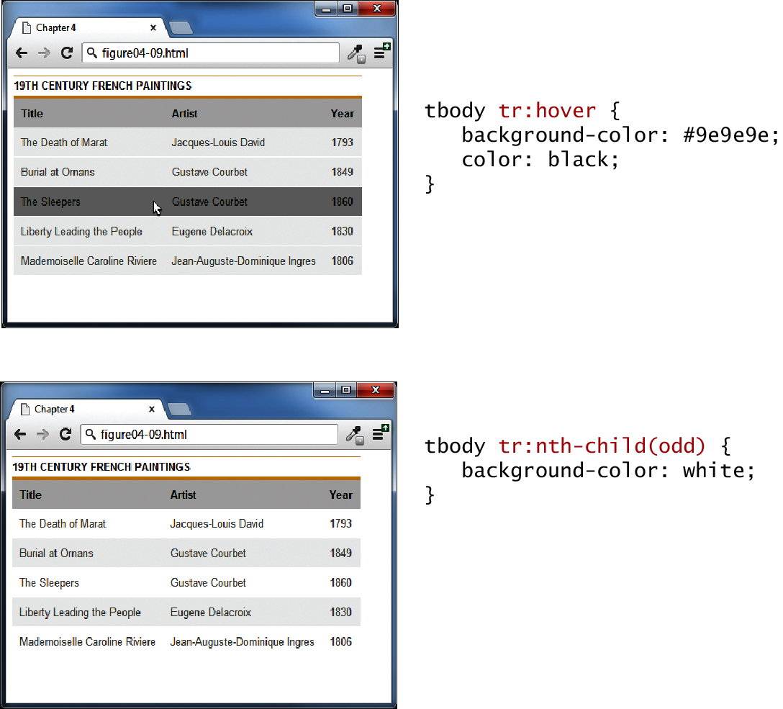
Nth-Child
Nifty Table styling tricks: hover effect and zebra-stripes

Slide 17
HTML Forms
Richer way to interact with server
Forms provide the user with an alternative way to interact with a web server.
Forms provide rich mechanisms like:
  Text input : Search functionality
  Password input
  Options Lists
  Radio and check boxes

Slide 18
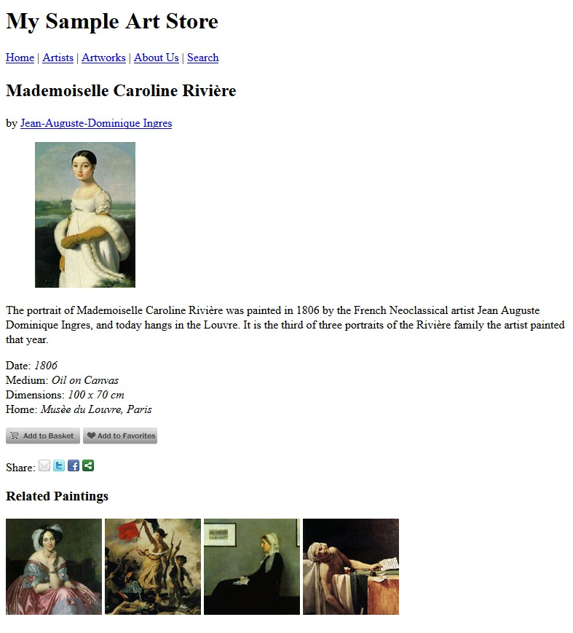
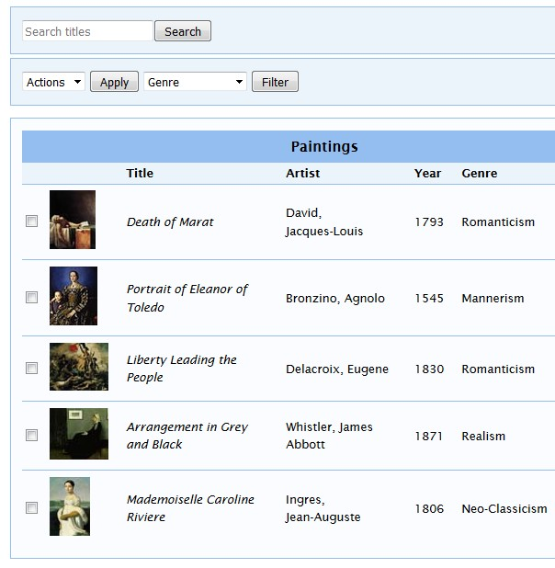
Static Vs Dynamic
Forms make pages dynamic
Static page
Dynamic
page
▪ Forms make pages dynamic

Slide 19

Overview of Forms
Forms are used all over the Web to:
  Accept information
  Provide interactivity
Types of forms:
– Search form, Order form, Newsletter sign-up form, Survey form, Add to Cart form, Login form, and so on…
23

Slide 20
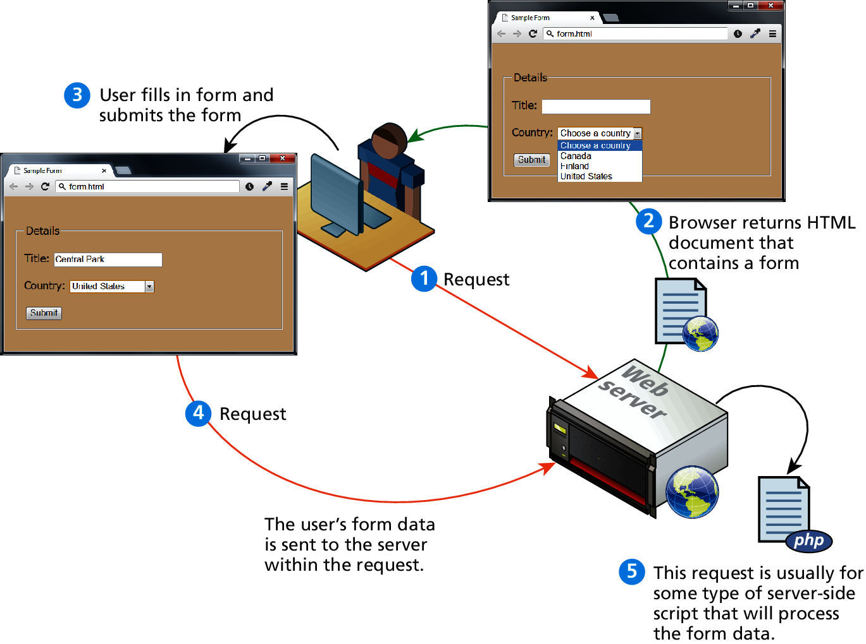
How forms interact with servers

Slide 21
Attributes of the <form> element:
name: identifier for the form
action: URL of the file that will process the data
method: HTTP method for submitting the data; “get” or “post”
[target]: where to open the pages specified in the action attribute; _blank opens in a new window or tab.

Slide 22
GET vs POST
Get: form data is sent as part of URL
  the data is visible and can be bookmarked
The URL when the form is submitted with the get method:
subscribe.php?email=zak%40modulemedia.com&submit=Subscribe
The data is after the ? and is called the query string
Post: form data is packaged as part of an HTTP request and isn’t visible by the browser
  more secure
  resulting page can’t be bookmarked
In either case: the same data is transmitted:
?email=zak%40modulemedia.com&submit=Subscribe

Slide 23
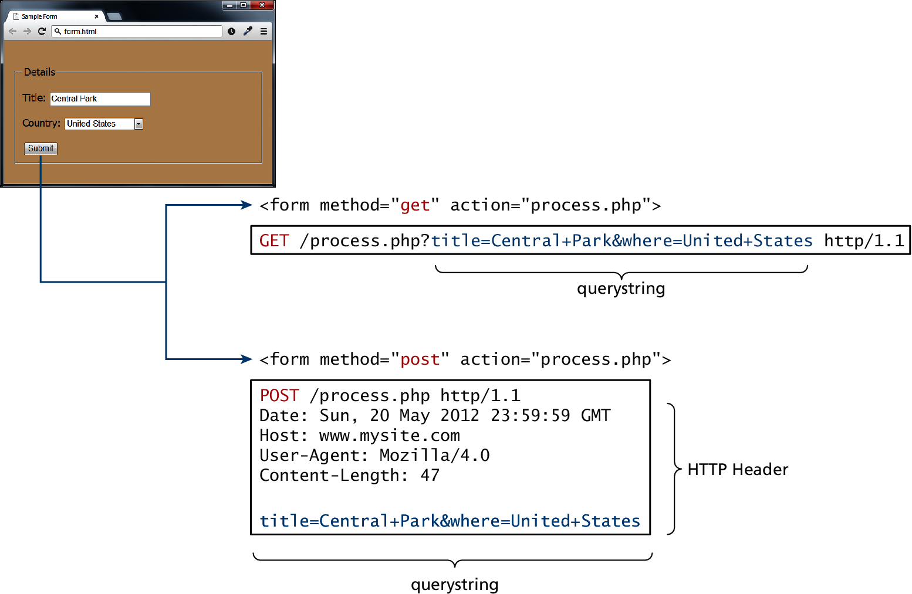
GET vs POST

Slide 24
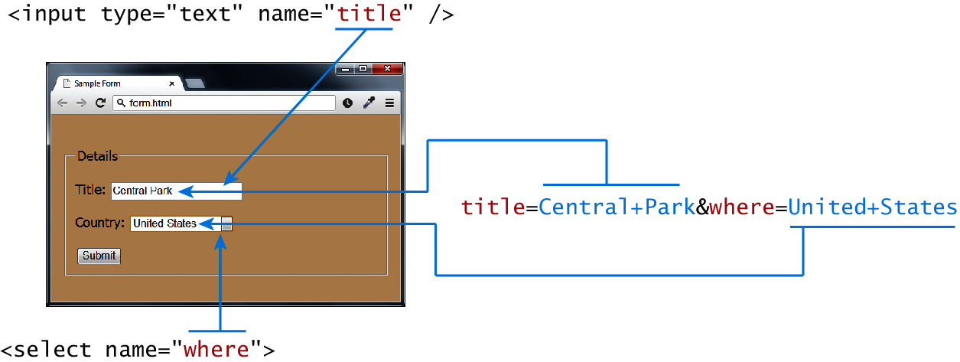
Query Strings

Slide 25
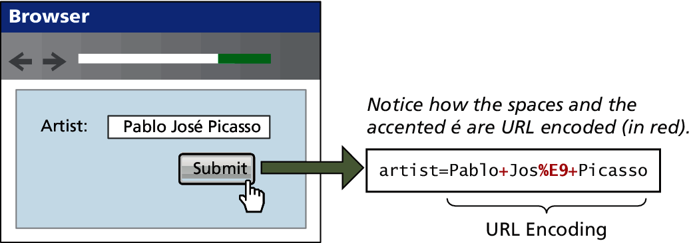
URL encoding
Special symbols
URLs, including and query strings:
  must use only characters from the ASCII character set
  may not contain spaces
Spaces are replaced with either + or %20
Other values not in the ASCII character set are URL-encoded according to the character set for the page
The default character set for HTML5 is UTF-8

Slide 26
GET vs POST
Advantages and Disadvantages
GET
Data can be clearly seen in the address bar.
Data remains in browser history and cache.
Data can be bookmarked
Limit on the number of characters in the form data returned.
POST
Data can contain binary data.
Data is hidden from user.
Submitted data is not stored in cache, history, or bookmarks.

Slide 27
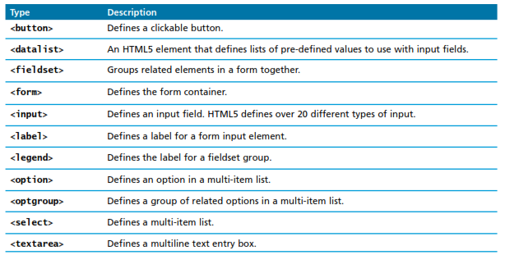
Form Control Elements

Slide 28
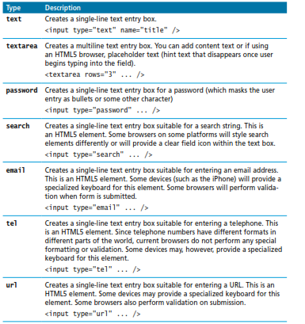
Text Input Controls
25

Slide 29

type="text"
First name:<input type="text"><br> Last name:<input type="text"><br>
The type= "text" attribute creates a 20-character box for user input.
How the HTML code above looks in a browser:

Slide 30

type="password"
Password:< input type="password">
This attribute creates a standard text box but with bullets instead of characters as the user types.
How the HTML code above looks in a browser:
Note: this does not encrypt the password; it simply provides a shield for anyone looking at the user’s screen.

Slide 31
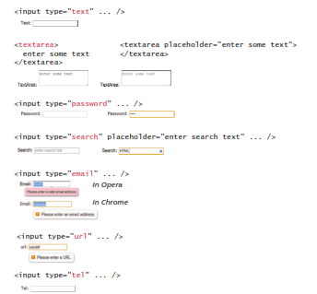

Slide 32
The Name Attribute
First name:< input type="text" name="firstname">
<br>
Last name:< input type="text" name="lastname">
<br>
Creates variables, firstname and lastname which hold the values of the strings entered into each text box.

Slide 33
Radio Buttons
Radio buttons are useful when you want the user to select a single item from a small list of choices and you want all the choices to be visible
radio buttons are added via the <input type="radio">
element
The buttons are mutually exclusive (i.e., only one can be chosen) by sharing the same name attribute
The optional checked attribute is used to indicate the default choice
the value attribute works in the same manner as with the <option> element.

Slide 34

Radio Buttons
Radio buttons let a user select ONLY ONE of a limited number of choices:
< input type="radio" name="gender" value="m"> Male<br>
< input type="radio" name="gender" value="f"> Female<br>
How the HTML code above looks in a browser:
Note: The name attributes are the same. Why?

Slide 35
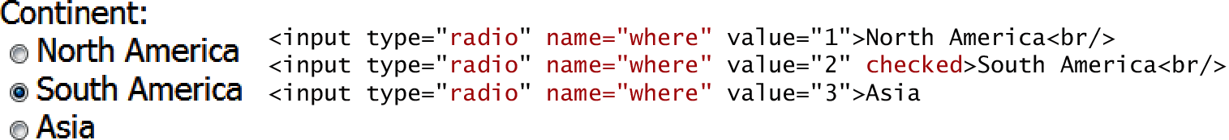
Radio Buttons
**Note: because only 1 value is returned, the name attributes should all be the same.

Slide 36
Checkboxes
Checkboxes are used for getting yes/no or on/off responses from the user.
checkboxes are added via the <input type="checkbox”>
element
You can also group checkboxes together by having them share the same name attribute
Each checked checkbox will have its value sent to the server
Like with radio buttons, the checked attribute can be used to set the default value of a checkbox

Slide 37

Checkboxes
Checkboxes let a user select ZERO or MORE options of a limited number of choices.
< input type="checkbox" name="bike"> I have a bike<br>
< input type="checkbox" name="car"> I have a car <br>
Note: The name attributes are different. Why?

Slide 38

Selection
Selection, or drop-down, lists typically allow the user to select one value from a list of options.
<select name="cars">
<option value="volvo">Volvo</option>
<option value="saab">Saab</option>
<option value="fiat">Fiat</option>
<option value="audi">Audi</option>
</select>
Fundamentals of
WWeebb DDeevveellooppmmeenntt

Slide 39
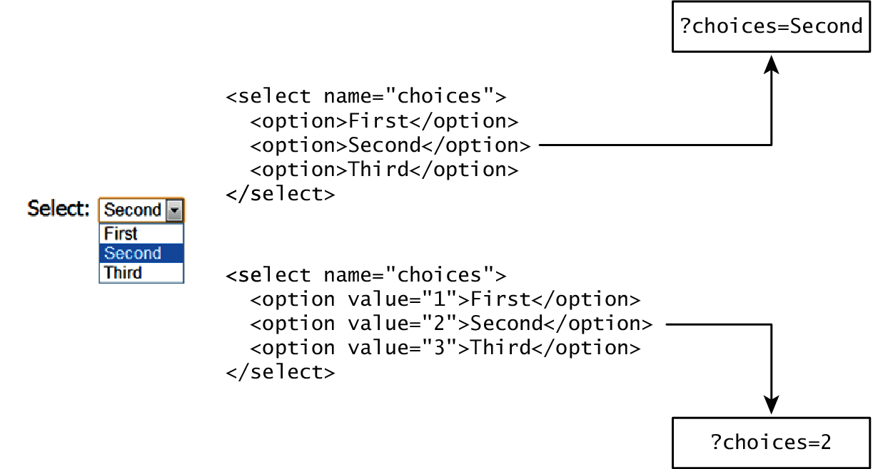
Which Value to send
Select Lists Cont.
The value attribute of the <option> element is used to specify what value will be sent back to the server.
The value attribute is optional; if it is not specified, then the text within the container is sent instead

Slide 40
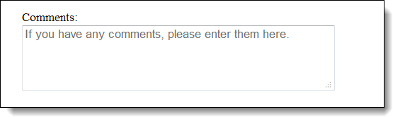
Text Areas
The HTML for a text area with default text:
Comments:<br>
<textarea name="comments" placeholder="If you have any comments, please enter them here.">
</textarea>
Note: This input will require special handling. More to come about that later…

Slide 41

type= "submit"
The submit button is used to send form data somewhere for processing. The data is sent to the page specified in the form's action attribute. The file defined in the action attribute usually does something with the received input:
Username: <input type="text" name="user">
<input type="submit" value="Submit">
The value attribute specifies the text to display on the button
How the HTML code above looks in a browser:

Slide 42
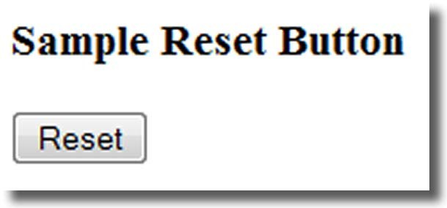
type= "reset"
<input type= "reset" value= "Reset">
The value attribute specifies the text to display on the button
38

Slide 43
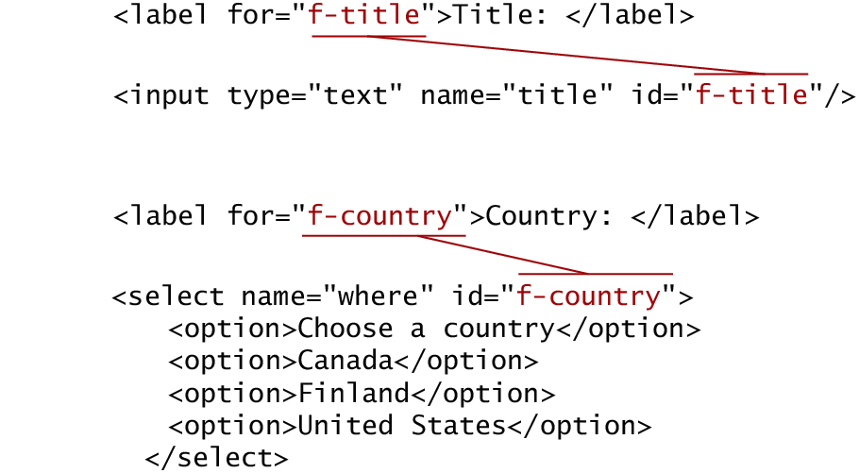
Accessible Forms
Recall the <fieldset>, <legend>, and <label> elements.
Each <label> element should be associated with a single input element.

Slide 44
Accessible Forms
Recall the <fieldset>, <legend>, and <label> elements.
Each <label> element can also be associated with a single input element by wrapping it around the element (but watch for nesting rules).
<p>Client Type:
<label> <input type="radio" name="type" value="School">School</label>
<label><input type="radio" name="type" value="College">College</label>
<label><input type="radio" name="type" value="University">University</label>
</p>

Slide 45
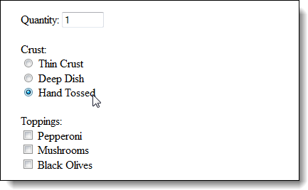
Accessibility guideline
Use labels to associate text with form input controls so the user can click on the label text to select the control that the label is associated with. This also helps assistive devices.

Slide 46
Label element
<label></label>
Associates a text label with a form control
Two Different Formats:
▪
<label>
<input type="radio" name= "crust" value= "hand"> Hand
Tossed
</label>
Or
<label for="email" >Email: </label>
<input type="text" name="CustEmail" id= "email">
42

Slide 47
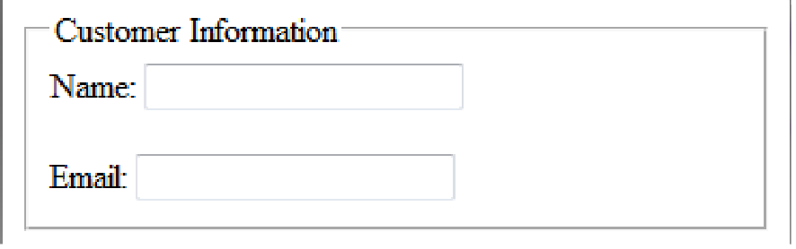
Fieldset and Legend Elements
The Fieldset Element
  Container tag
  Creates a visual group of form elements on a web page
The Legend Element
  Container tag
  Creates a text label within the fieldset
<fieldset><legend>Customer Information</legend>
<label>Name:
<input type="text" name=“name" id="Name"></label>
<br><br>
<label>Email:
<input type="text" name="Email" id="Email"></label>
</fieldset>
43

Slide 48
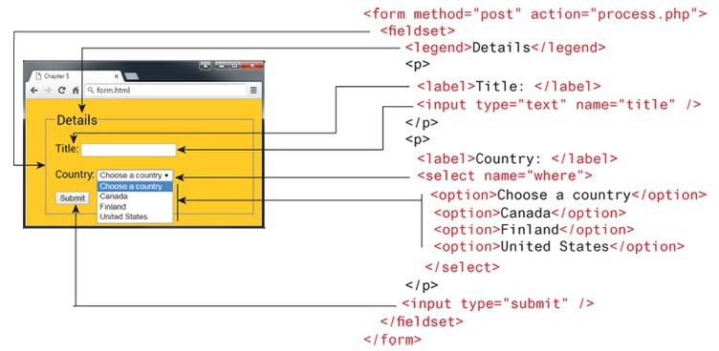
Putting It All Together
One form element containing the desired controls:

Slide 49
Button Controls
Preferred
 | Type |  | Description
 | <input type="submit"> |  | Creates a button that submits the form data to the server. May have a value = " " attribute to control the text that displays on the button.
 | <input type="reset"> |  | Creates a button that clears any of the user’s already entered form data. May have a value = " " attribute to control the text that displays on the button.
 | <input type="button"> |  | Creates a custom button. This button may require Javascript for it to actually perform any action.
 | <input type="image"> |  | Creates a custom submit button that uses an image for its display.
 | <button> |  | Creates a custom button. The <button> element differs from <input type="button"> in that you can completely customize what appears in the button; using it, you can, for instance, include both images and text, or skip server-side processing entirely by using hyperlinks. You can turn the button into a submit button by using the type="submit" attribute.

Slide 50
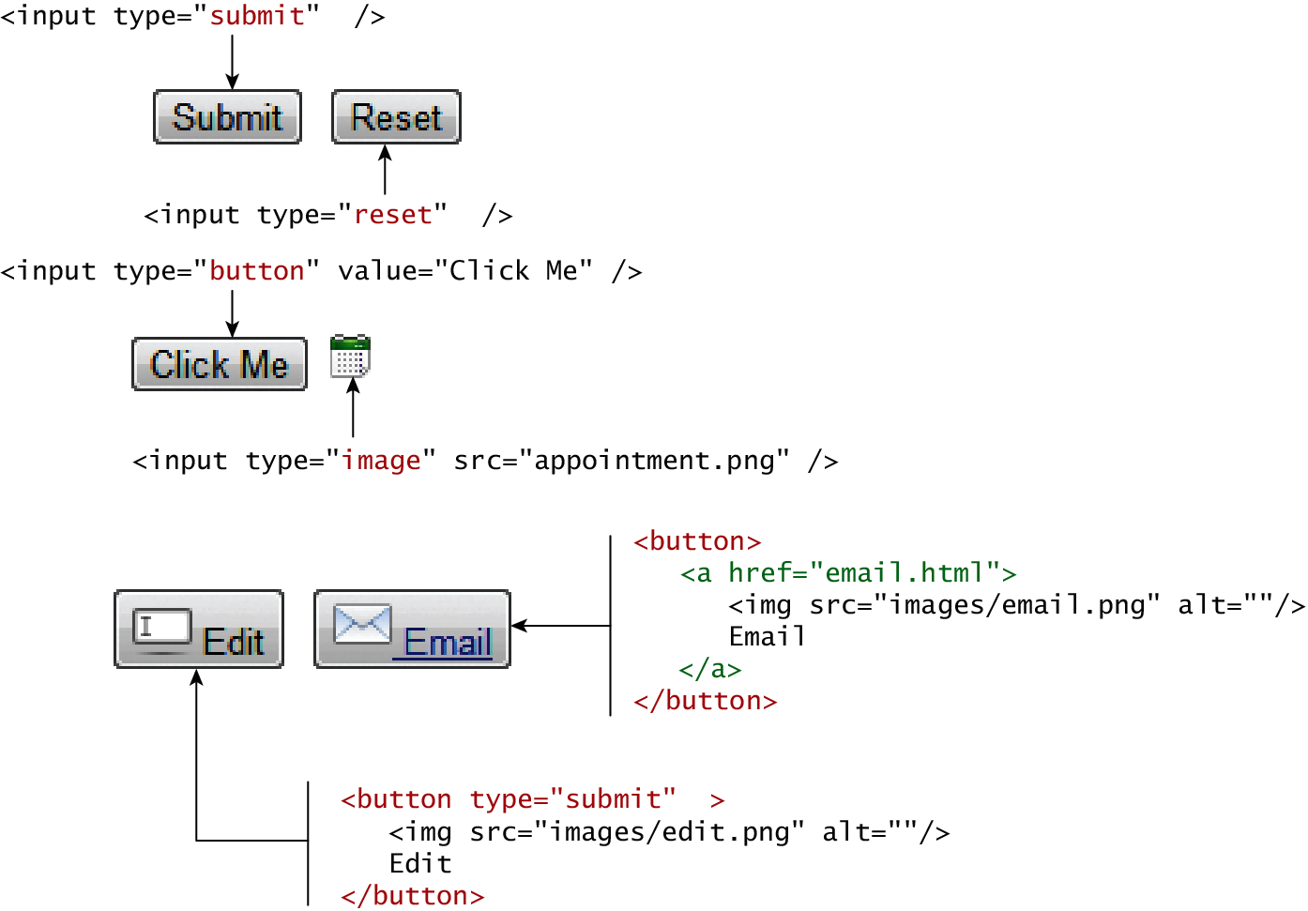
Button Controls

Slide 51
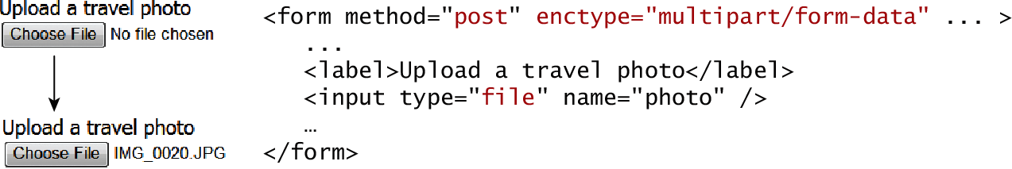
Specialized Controls
<input type="hidden">
Use the hidden type attribute for sending string values along with other data that the user doesn’t see or input – a product ID for example:
<input type="hidden" name="productid" value="C1003">
<input type="file">

Slide 52
Number and Range
Typically input values need to be validated. Although server side validation is required, optional client side pre- validation is good practice.
The number and range controls Added in HTML5 provide a way to input numeric values that eliminates the need for JavaScript numeric validation!!!

Slide 53
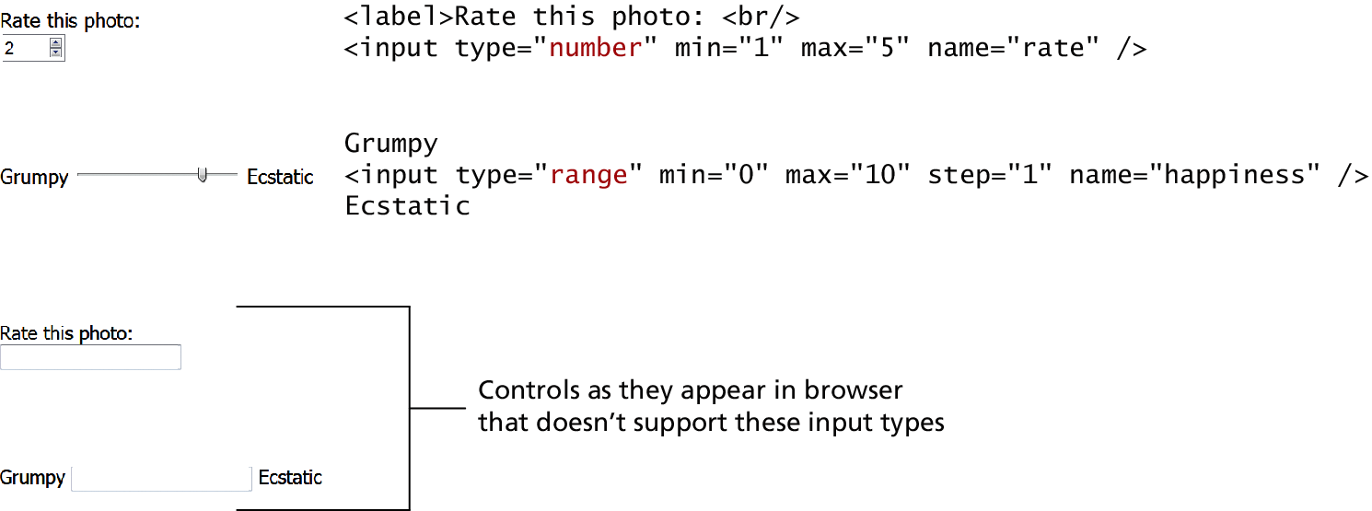
Number and Range

Slide 54
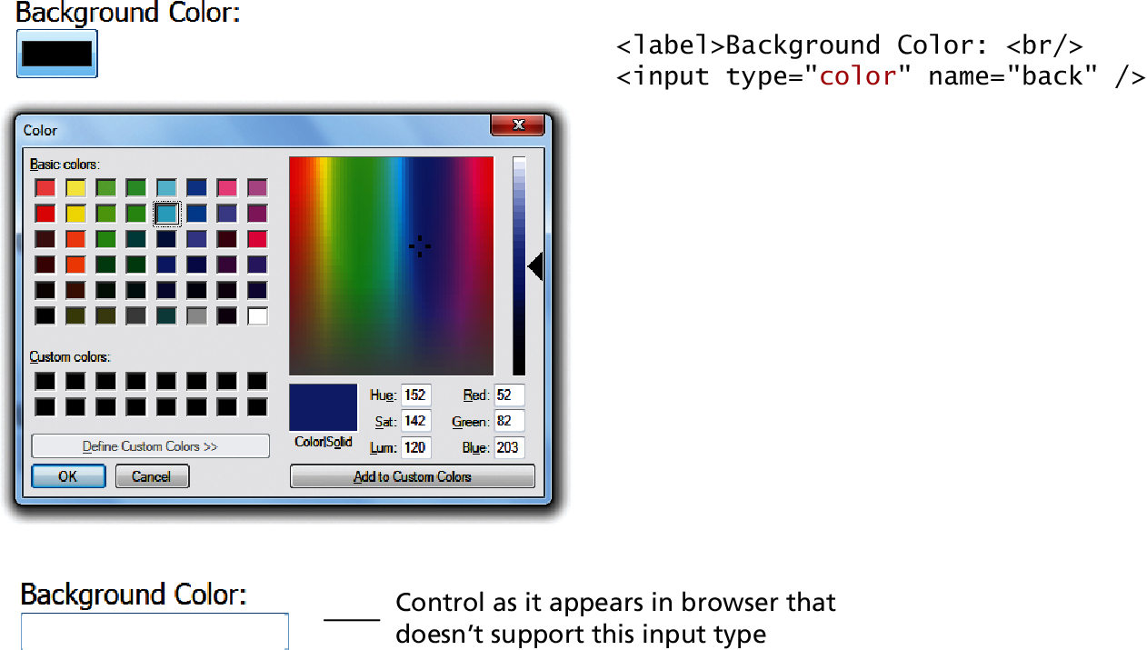
Color

Slide 55
Date and Time Controls
Dates and times often need validation when gathering this information from a regular text input control.
From a user’s perspective, entering dates can be tricky as well: you probably have wondered at some point in time when entering a date into a web form, what format to enter it in, whether the day comes before the month, whether the month should be entered as an abbreviation or a number, and so on.
It's always a good idea to let the user know what format you expect.

Slide 56
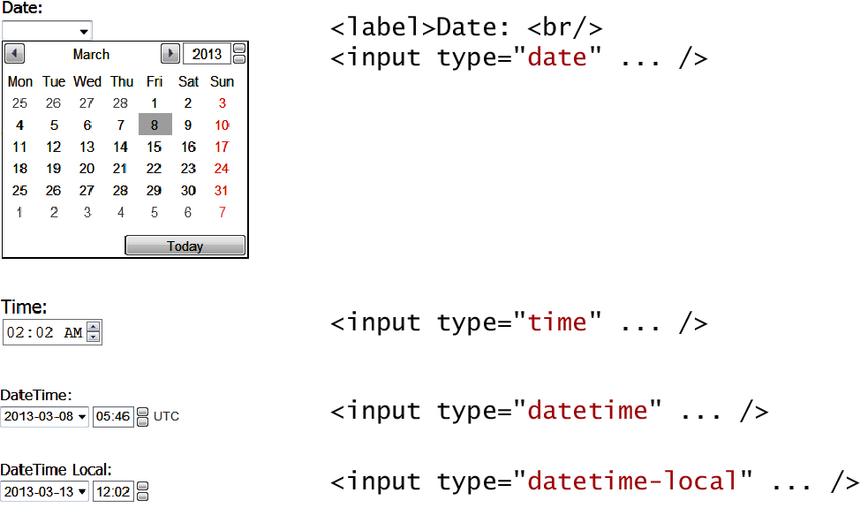
HTML5 Date and Time Controls

Slide 57
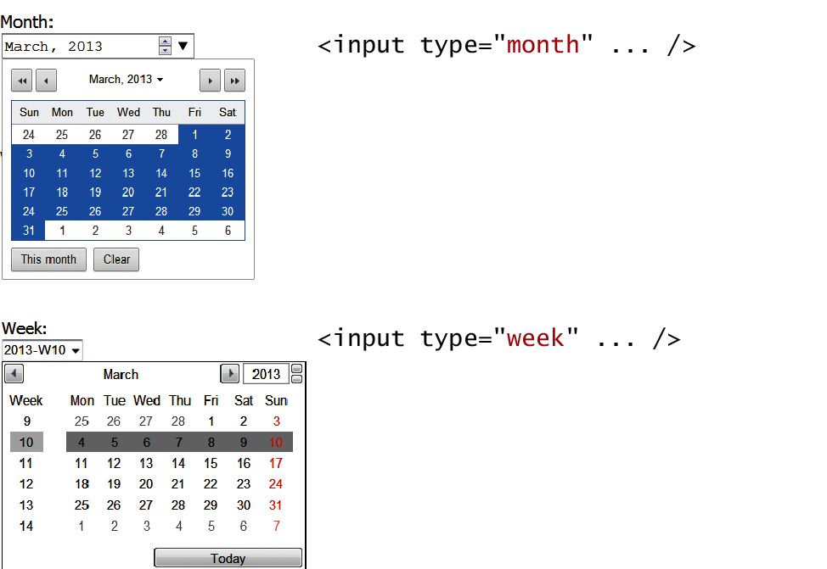
HTML5 Date and Time Controls

Slide 58
HTML Controls
Type | Description
date | Creates a general date input control. The format for the date is "yyyy-mm-dd".
time | Creates a time input control. The format for the time is "HH:MM:SS", for hours:minutes:seconds.
datetime | Creates a control in which the user can enter a date and time.
datetime- local | Creates a control in which the user can enter a date and time without specifying a time zone.
month | Creates a control in which the user can enter a month in a year. The format is "yyyy-mm".
week | Creates a control in which the user can specify a week in a year. The format is "yyyy-W##".

Slide 59
HTML5
HTML 5 will support several new input types such as:
Color, date, email, etc. Check the following site for browser compatibilities:
http://www.w3schools.com/html/html_form_input_types.asp

Slide 60
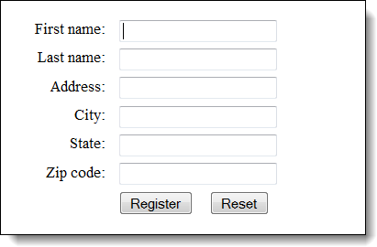
Formatting
Aligned label, text box, and button controls

Slide 61
The HTML for the form
<label for="firstname">First name:</label>
<input type="text" name="firstname" id="firstname" autofocus><br>
<label for="lastname">Last name:</label>
<input type="text" name="lastname" id="lastname"><br>
<label for="address">Address:</label>
<input type="text" name="address" id="address"><br>
<label for="city">City:</label>
<input type="text" name="city" id="city"><br>
<label for="state">State:</label>
<input type="text" name="state" id="state"><br>
<label for="zip">Zip code:</label>
<input type="text" name="zip" id="zip"><br>
<input type="submit" name="register" id="button" value="Register">
<input type="reset" name="reset" id="reset" value="Reset">

Slide 62
The CSS for the controls
label {
float: left; width: 5em;
text-align: right;} input {
margin-left: 1em; margin-bottom: .5em;}
#button {
margin-left: 7em;}

Slide 63
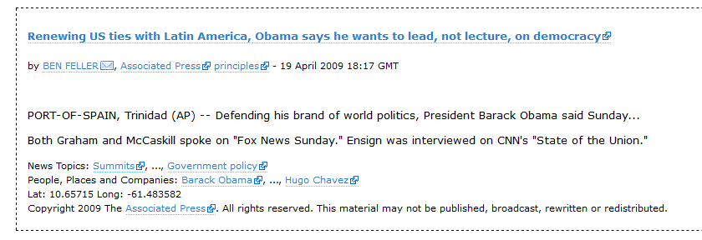
Microformats
A microformat is a small pattern of HTML markup and attributes to represent common blocks of information such as people, events, and news stories so that the information in them can be extracted and indexed by software agents
hCard – markup contact information
hNews – richly formatted, standardized markup:

Slide 64
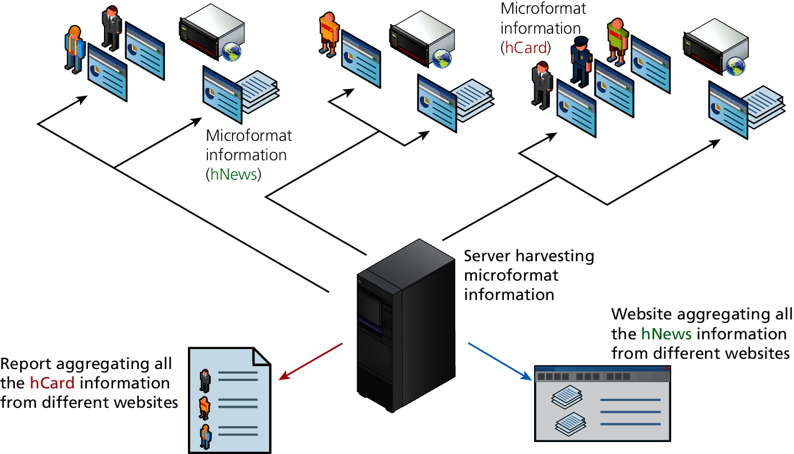
Microformat

Slide 65
What you’ve learned
₂ Styling Tables ₄ Form Control Details ₆ Microformats
1
Introducing Tables
₃ Introducing Forms
5
Table and Form Accessibility

